Slide 1
Vaccination sentiment in Twitter networks
Rachel Lemon Lin Reimer
Professor Gregory Eirich
Quantitative Methods in the Social Sciences
Columbia University Graduate School for the Arts and Sciences

Slide 2
Vaccine hesitancy is on the rise
On Twitter alone, the number of vaccine hesitant users doubled from 2016 to 2019.₁

Slide 3


A tweet is worth 280 characters
This study attempts to use social network analysis in tandem with natural language processing to estimate the persuasive power of two tweets, one pro-vaccination and the other against vaccination.

Slide 4
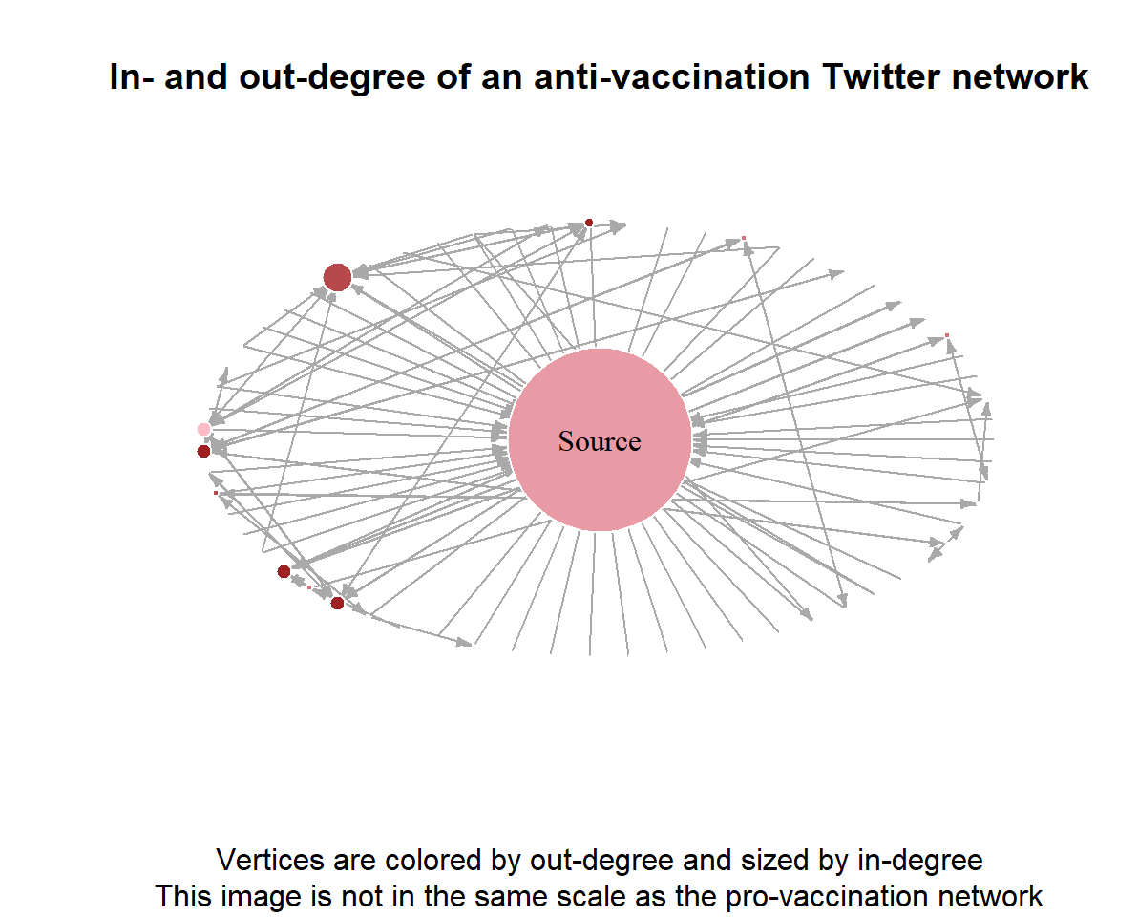
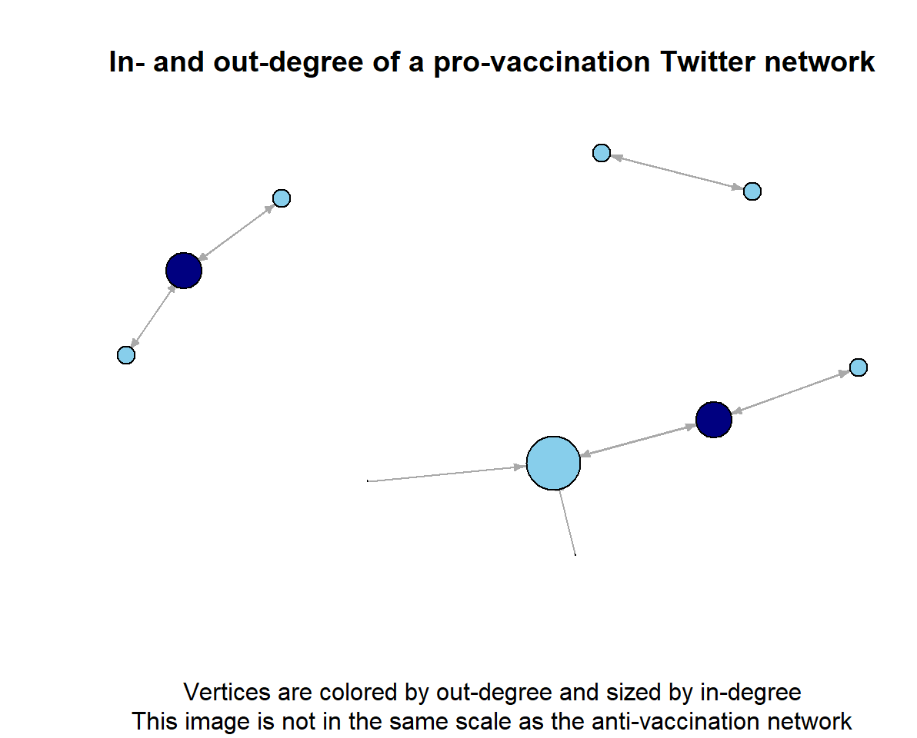
Network structure

Slide 5
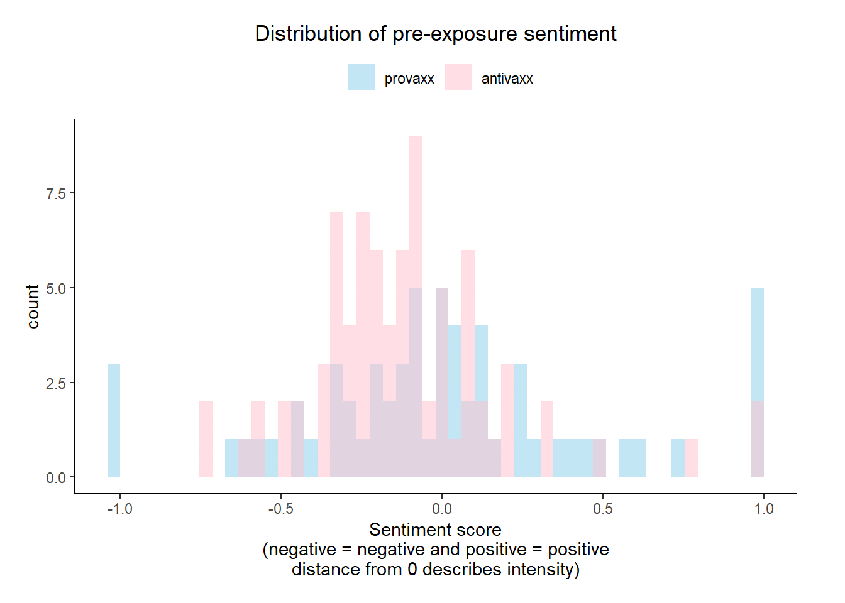
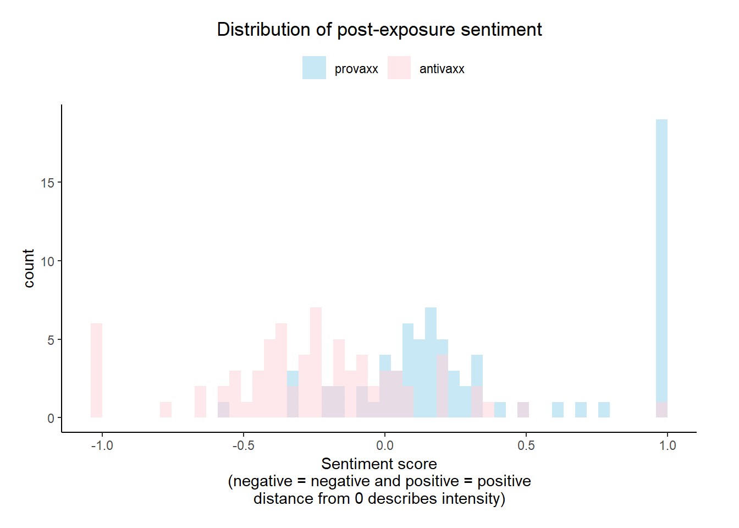

Slide 6

This is a slide title
Conclusions and recommendations
Here you have a list of items
And some text
But remember not to overload your slides with content
Your audience will listen to you or read the content, but won’t do both.
Vaccination tweets are persuasive and polarizing
The vaccine hesitant community is small and more densely connected
The pro-vaccination community is large and less densely connected
Expect twitter interventions to be ineffective
More tweets should be explored than just two

Slide 7
References
Gunaratne, K., Coomes, E. A., & Haghbayan, H. (2019). Temporal trends in anti-vaccine discourse on Twitter. Vaccine, 37(35), 4867–4871. https://doi.org/10.1016/j.vaccine.2019.06.086

